Slide 1
Software Development Internship Program Presentation
A presentation about my first six weeks at S&P Dow Jones Indices
Salvador Villalon
Software Development Intern
S&P Dow Jones Indices / Web Technology Team
August 1, 2018

Slide 2
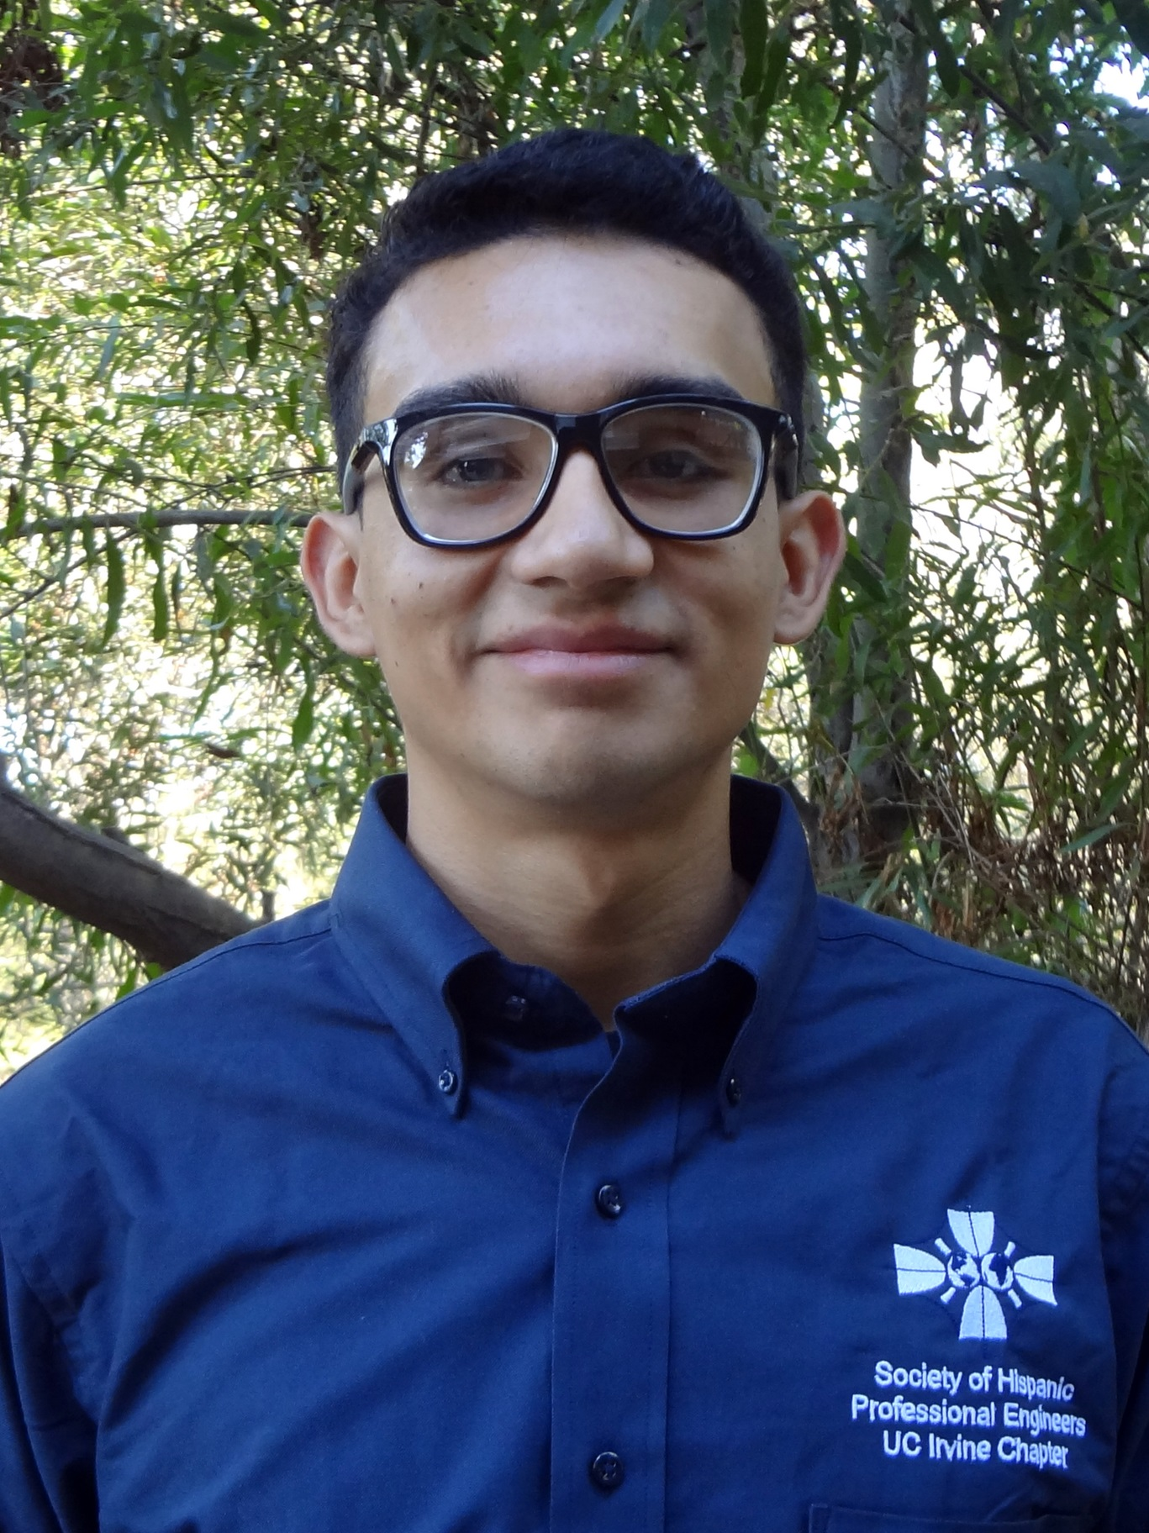

About Salvador Villalon
Name: Salvador Villalon
University: University of California, Irvine
Major: Computer Science
Business Unit: S&P Dow Jones Indices
Team: Web Technology Team
Manager: Sharath Srinivas

Slide 3
The Experience

Slide 4
Week 1 & 2

Slide 5
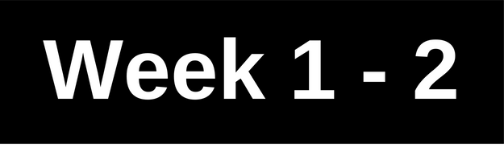


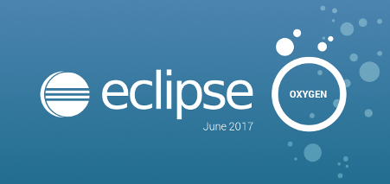
Project 1: Four Enhancements for Vault and IDS Web Platform
The Task
Creating update SQL scripts
Change HTML code for specific files in the platforms
Biggest Takeaway
Commit and Push code to a Team Repository
Git: Not the only revision control system
Importance of requirements
More use of Eclipse
Technologies Used/Learned
Java Server Pages
Git
SVN
GitHub Desktop
Eclipse
Java
Toad for Oracle

Slide 6
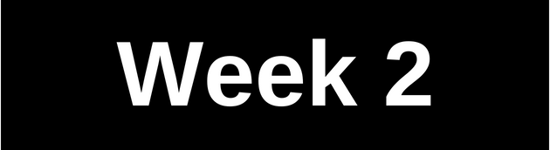
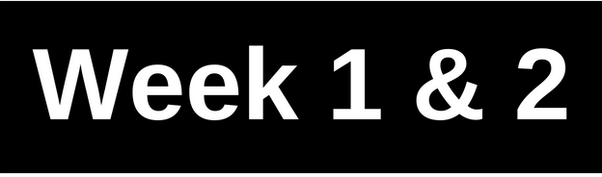
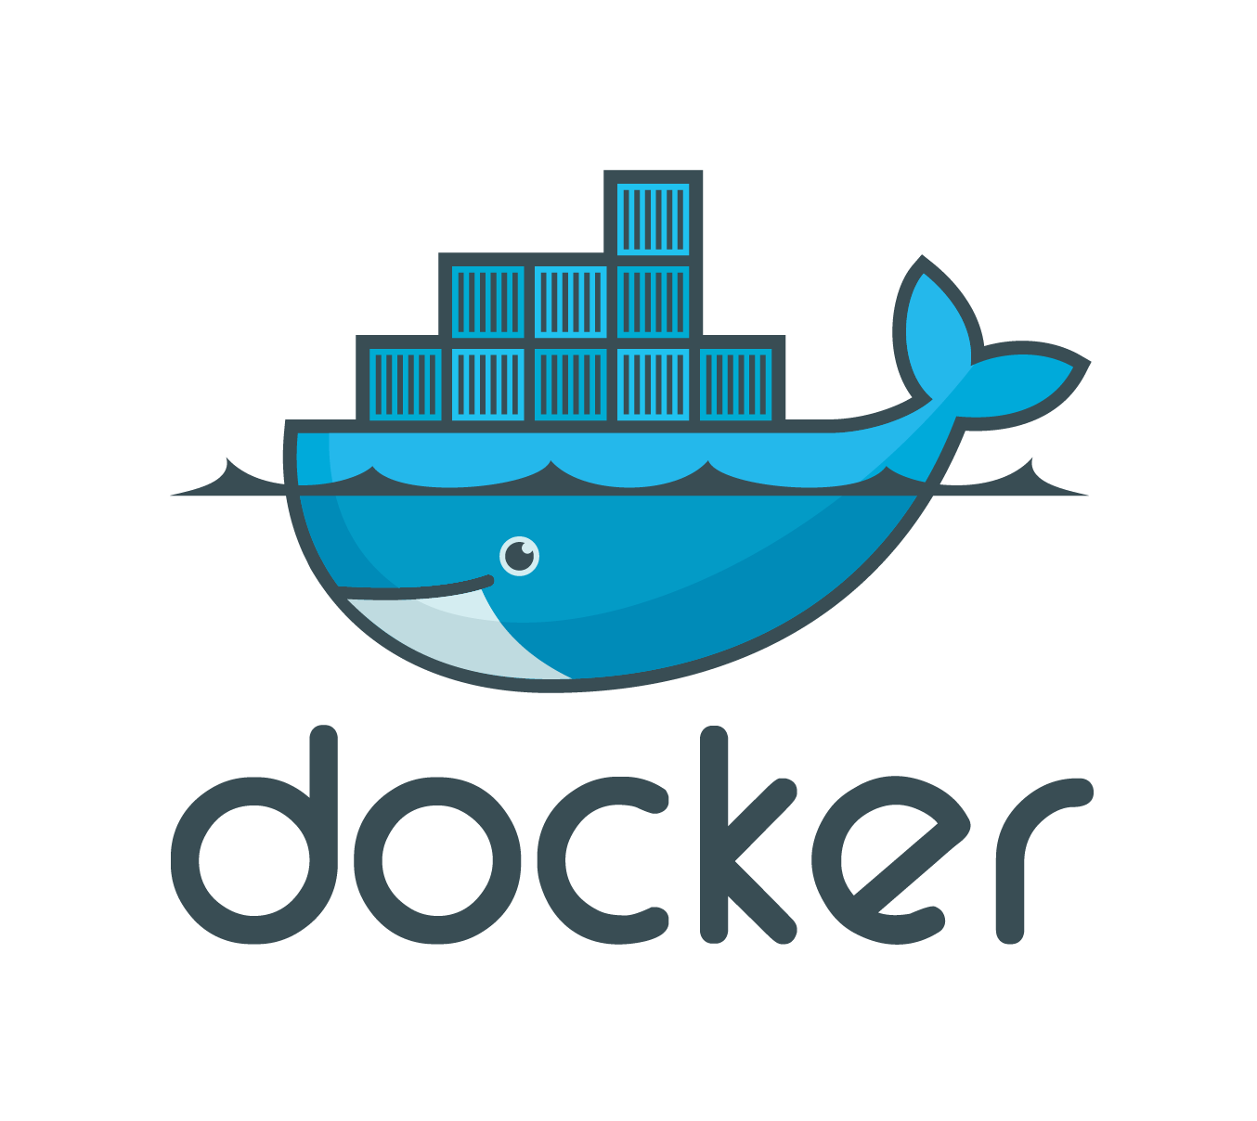
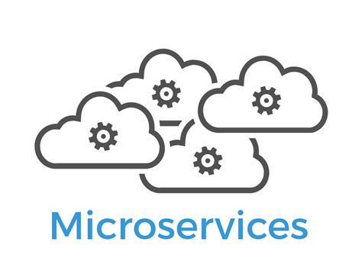
Project 2: Learning about Containers, Open Source Technologies, and Microservices
The Task
Run web application on a container
Make presentation on what I have learned
Biggest Takeaway
Container: unit that contains everything
needed to run the application
New opportunities
Technologies Used/Learned
Docker
Microservices
Docker Command Line Tool

Slide 7
Week 3 - 5

Slide 8

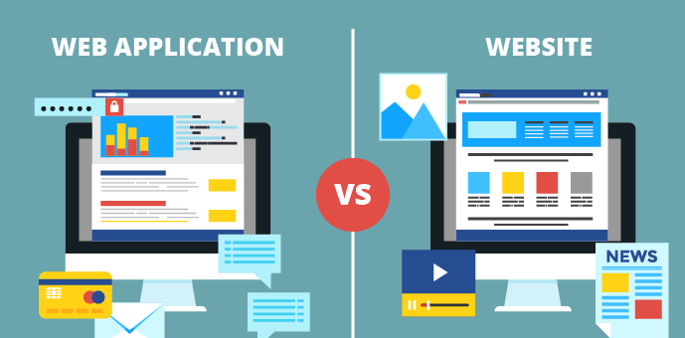
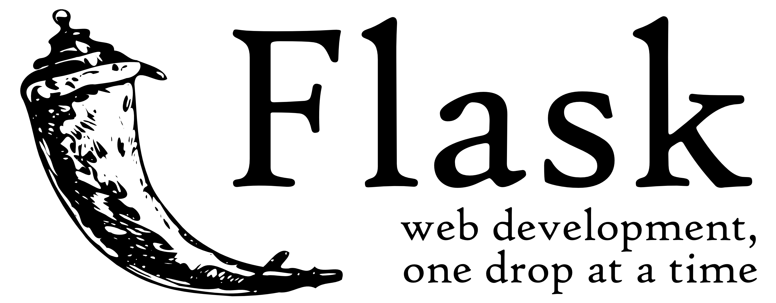
Project 3: Web Applications with Flask (A Python Microframework)
The Task
To understand Docker Tutorials, decided to learn Flask
Run a web application on a container
Make presentation on learning
Biggest Takeaway
What a web application is
Client Side and Server Side
Python and Flask as the Server Side
Technologies Used/Learned
HTML
CSS
Python
Flask
Web Application
Client Side and Server Side

Slide 9
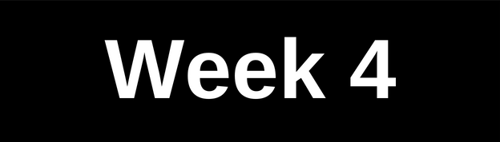
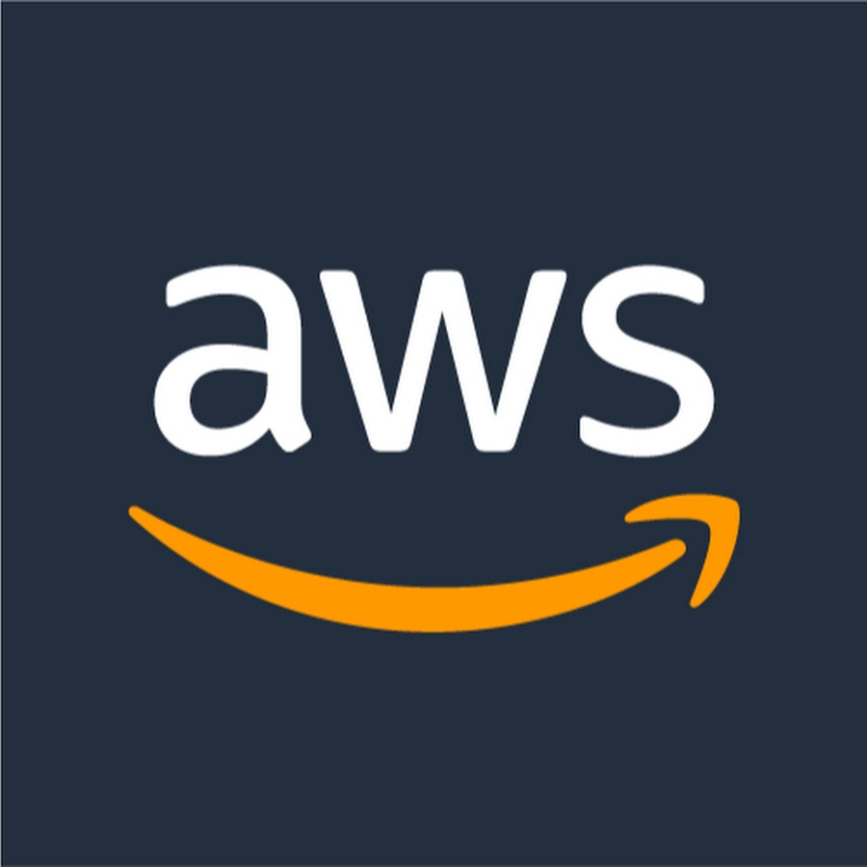
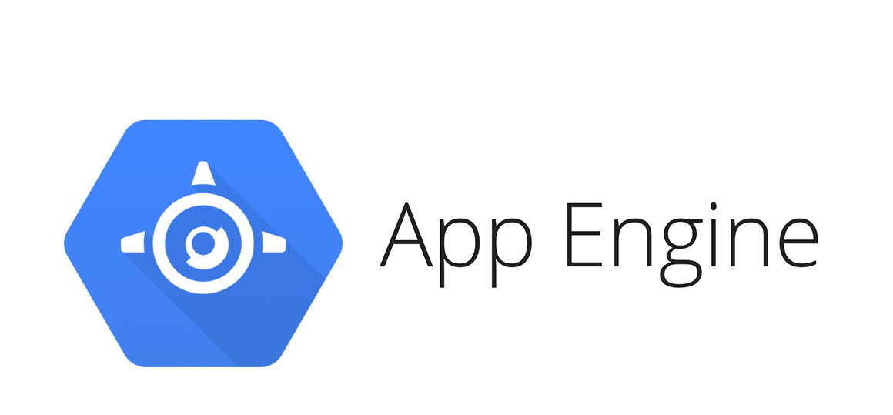
Project 4: Playing with Cloud Services
The Task
Show others the projects
Cloud services allows me to deploy web applications
Biggest Takeaway
Cloud Services like: Heroku, AWS, Google App Engine, PythonAnywhere
Process to deploy a web application
GitHub Pages vs. Cloud Services
Technologies Used/Learned
Heroku
AWS
Google App Engine
Git
GitHub

Slide 10
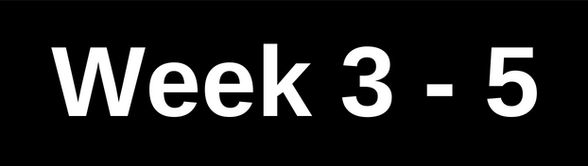

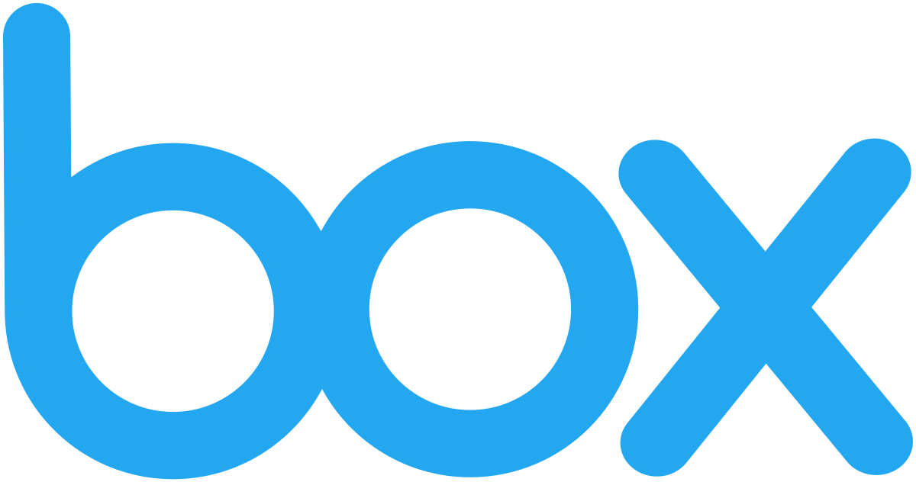
Project 5: Creating a RESTful Client and Using APIs
The Task
Part 1:
Enhancement for CARE web platform
Tasked with creating a RESTful client that consumes the Box RESTful API
Part 2:
Create a Java class to represent any error from API call
In this project, I used my Spanish speaking and writing skills to collaborate with Developers from S&P Global Mexico City office
Continue on next slide
RESTful API
Notes:
Preguntale a Alex por que hizimos parte 2

Slide 11
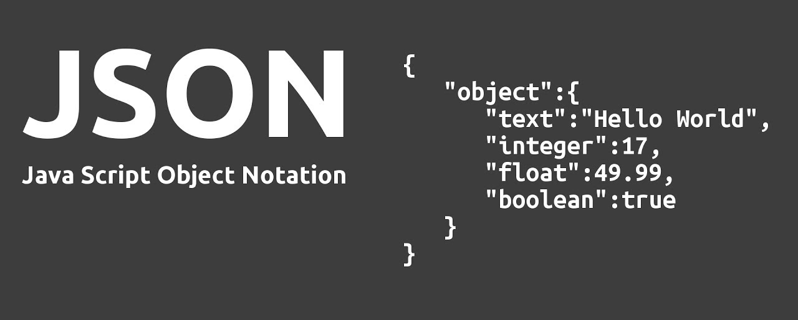
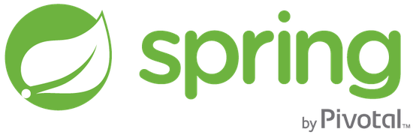
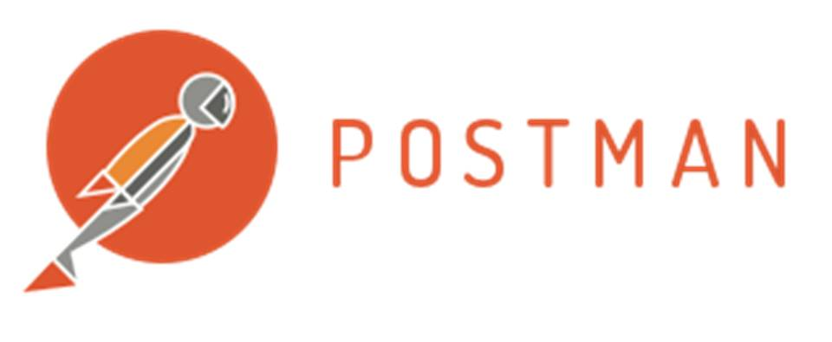
Project 5: Creating a RESTful Client and Using APIs
Biggest Takeaway
Application Programming Interface (API)
RESTful APIs
JavaScript Object Notation (Json)
Spring Framework
Postman
Technologies Used/Learned
Eclipse
Postman
Box API
Json
Java
Java Spring Framework

Slide 12
Next Steps

Slide 13
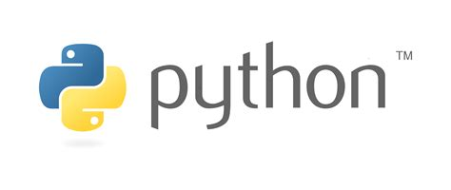
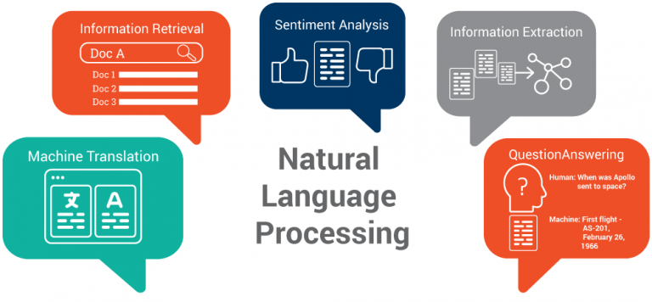
Next Steps
Machine Learning using Python and libraries like NLTK
Create a post in The Hub to help others deploy a Web Application using Flask

Slide 14
Summary

Slide 15
Summary
5 Projects
Technologies Used/Learn – 17 Total
Won the S&P Global Summer Hashtag Contest – #mySPGSummer2018
Beat my Recruiter, Rahim Babar, in Table Tennis
Eclipse
Postman
Box RESTful API
Java
Spring Framework
Python
Flask
HTML
CSS
Google App Engine
Git
GitHub
Docker
Microservices
Web Application
Client Side and Server Side
Subversion

Slide 16

Thank You
Contact Info
LinkedIn: https://www.linkedin.com/in/salvadorvillalon/
Website: http://salvador-villalon.appspot.com/
Email: salvador.villalon@spglobal.com

